Slide 1
Telecommunication churn Prediction

Slide 2
Business Objective
Predicting customer churn is critical for telecommunication companies to be able to effectively retain customers. It is more costly to acquire new customers than to retain existing ones. For this reason, large telecommunications corporations are seeking to develop models to predict which customers are more likely to change and take actions accordingly.
We build a model to predict how likely a customer will churn by analyzing its characteristics. The objective is to obtain a data-driven solution that will allow us to reduce churn rates and, as a consequence, to increase customer satisfaction and corporation revenue.

Slide 3
Data Set
The data set used in this project is sent from ExcelR Solutions and contains nineteen columns (independent variables) that indicate the characteristics of the clients of a fictional telecommunications corporation. The Churn column (response variable) indicates whether the customer departed within the last month or not. The class 'No' includes the clients that did not leave the company last month, while the class 'Yes' contains the clients that decided to terminate their relations with the company. The objective of the analysis is to obtain the relation between the customer’s characteristics and the churn.

Slide 4
Steps of the project
The project consists of the following sections:
Data Reading
Exploratory Data Analysis and Data Cleaning
Data Visualization
Feature Importance
Feature Engineering
Setting a baseline
Splitting the data in training and testing sets
Assessing multiple algorithms
Algorithm selected: Gradient Boosting
Hyperparameter tuning
Performance of the model
Drawing conclusions — Summary

Slide 5
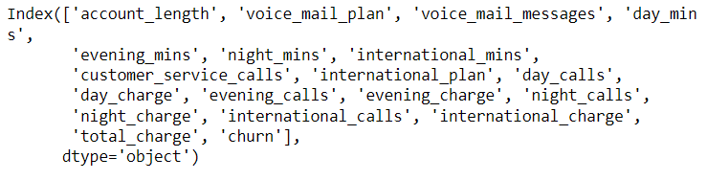
Data Reading
The first step of the analysis consists of reading and storing the data in a Pandas data frame using the pandas.read_csv function.
As shown above, the data set contains 19 independent variables.

Slide 6
Exploratory Data Analysis and Data Cleaning
Exploratory data analysis consists of analyzing the main characteristics of a data set usually by means of visualization methods and summary statistics. The objective is to understand the data, discover patterns and anomalies, and check assumptions before performing further evaluations.
At the beginning of EDA, we want to know as much information as possible about the data, this is when the pandas.DataFrame.info method comes in handy. This method prints a concise summary of the data frame, including the column names and their data types, the number of non-null values, and the amount of memory used by the data frame.
The data set contains 3333 observations and 19 columns. Apparently, there are no null values on the data set.

Slide 7
Data Visualization
we are going to use normalized stacked bar plots to analyze the influence of each independent categorical variable in the outcome.
A normalized stacked bar plot makes each column the same height, so it is not useful for comparing total numbers; however, it is perfect for comparing how the response variable varies across all groups of an independent variable.
On the other hand, we use histograms to evaluate the influence of each independent numeric variable in the outcome. As mentioned before, the data set is imbalanced; therefore, we need to draw a probability density function of each class (density=True) to be able to compare both distributions properly.

Slide 8
Feature importance
Mutual information(analysis of linear and nonlinear relationships) measures the mutual dependency between two variables based on entropy estimations. In machine learning, we are interested in evaluating the degree of dependency between each independent variable and the response variable. Higher values of mutual information show a higher degree of dependency which indicates that the independent variable will be useful for predicting the target.
The Scikit-Learn library has implemented mutual information in the metrics package. The following code computes the mutual information score between each categorical variable of the data set and the Churn variable.
Mutual information allows us not only to better understand our data but also to identify the predictor variables that are completely independent of the target. The mutual information score really close to 0, meaning those variables do not have a strong relationship with the target. we should consider removing those variables from the data set before training as they do not provide useful information for predicting the outcome.
The mutual information extends the notion of correlation to nonlinear relationships since, unlike Pearson’s correlation coefficient, this method is able to detect not only linear relationships but also nonlinear ones.

Slide 9
Feature Engineering
Feature engineering is the process of extracting features from the data and transforming them into a format that is suitable for the machine learning model. In this project, we need to transform both numerical and categorical variables. Most machine learning algorithms require numerical values; therefore, all categorical attributes available in the dataset should be encoded into numerical labels before training the model. In addition, we need to transform numeric columns into a common scale. This will prevent that the columns with large values dominate the learning process.
All transformations will be implemented using only Pandas. However, we’ll also use an alternative implementation using Scikit-Learn.

Slide 10
Normalization
Data Normalization is a common practice in machine learning which consists of transforming numeric columns to a common scale. In machine learning, some feature values differ from others multiple times. The features with higher values will dominate the learning process; however, it does not mean those variables are more important to predict the target. Data normalization transforms multiscaled data to the same scale. After normalization, all variables have a similar influence on the model, improving the stability and performance of the learning algorithm.
There are multiple normalization techniques in statistics. In this project, we will use the min-max method to rescale the numeric columns to a common scale.
The min-max approach (often called normalization) rescales the feature to a fixed range of [0,1] by subtracting the minimum value of the feature and then dividing by the range.

Slide 11
Setting a baseline
In machine learning, we often use a simple classifier called baseline to evaluate the performance of a model. In this classification problem, the rate of customers that did not churn (most frequent class) can be used as a baseline to evaluate the quality of the models generated. These models should outperform the baseline capabilities to be considered for future predictions.

Slide 12
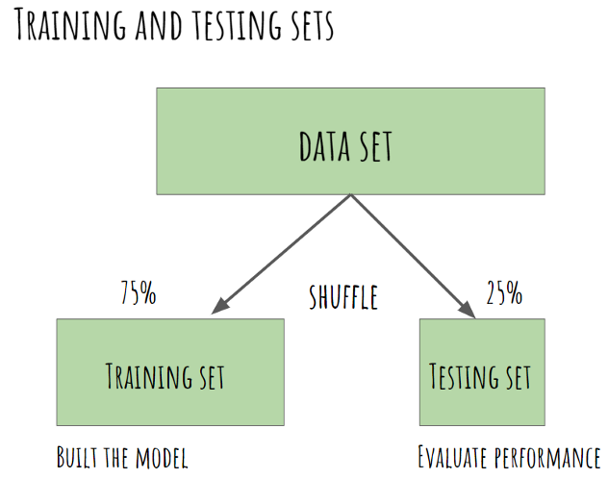
Splitting the data in training and testing sets
The first step when building a model is to split the data into two groups, which are typically referred to as training and testing sets. The training set is used by the machine learning algorithm to build the model. The test set contains samples that are not part of the learning process and is used to evaluate the model’s performance. It is important to assess the quality of the model using unseen data to guarantee an objective evaluation.
we can use the train_test_split function from the sklearn.model_selection package to create both the training and testing sets.

Slide 13
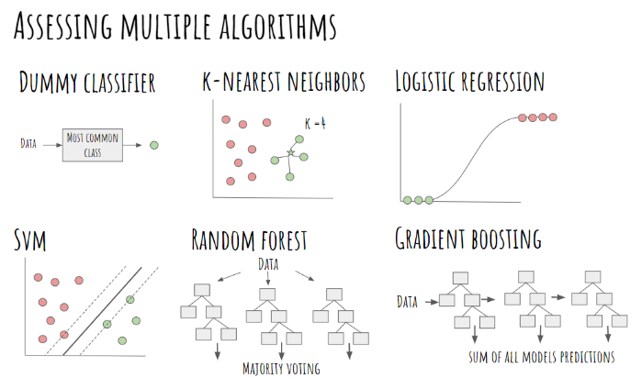
Assessing multiple algorithms
Algorithm selection is a key challenge in any machine learning project since there is not an algorithm that is the best across all projects. Generally, we need to evaluate a set of potential candidates and select for further evaluation those that provide better performance.
In this project, we compare 6 different algorithms, all of them already implemented in Scikit-Learn.
Dummy classifier (baseline)
K Nearest Neighbours
Logistic Regression
Support Vector Machines
Random Forest
Gradiente Boosting

Slide 14
Hyperparameters
We’ll use/train all the algorithms using the default hyperparameters. The accuracy of many machine learning algorithms is highly sensitive to the hyperparameters chosen for training the model. A more in-depth analysis will include an evaluation of a wider range of hyperparameters (not only default values) before choosing a model (or models) for hyperparameter tuning.
We will only further evaluate the model that presents higher accuracy using the default hyperparameters.

Slide 15
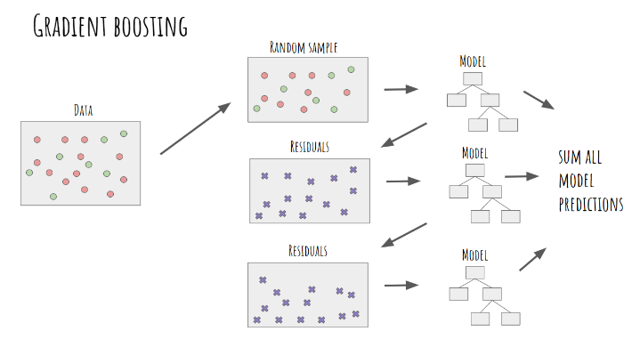
Algorithm selected: Gradient Boosting
Gradient Boosting is a very popular machine learning ensemble method based on a sequential training of multiple models to make predictions. In Gradient Boosting, first, we’ll make a model using a random sample of your original data. After fitting the model, we can make predictions and compute the residuals of the model. The residuals are the difference between the actual values and the predictions of the model. Then, we’ll train a new tree based on the residuals of the previous tree, calculating again the residuals of this new model. We repeat this process until we reach a threshold (residual close to 0), meaning there is a very low difference between the actual and predicted values. Finally, we can take a sum of all model forecasts (prediction of the data and predictions of the error) to make a final prediction.

Slide 16
We can easily build a gradient boosting classifier with Scikit-Learn using the GradientBoostingClassifier class from the sklearn.ensemble module. After creating the model, we need to train it (using the .fit method) and test its performance by comparing the predictions (.predict method) with the actual class values.
As shown in the Scikit-Learn documentation, the GradientBoostingClassifier has multiple hyperparameters; some of them are listed below:
learning_rate: the contribution of each tree to the final prediction.
n_estimators: the number of decision trees to perform (boosting stages).
max_depth: the maximum depth of the individual regression estimators.
max_features: the number of features to consider when looking for the best split.
min_samples_split: the minimum number of samples required to split an internal node.
The next step consists of finding the combination of hyperparameters that leads to the best classification of our data. This process is called hyperparameter tuning.

Slide 17
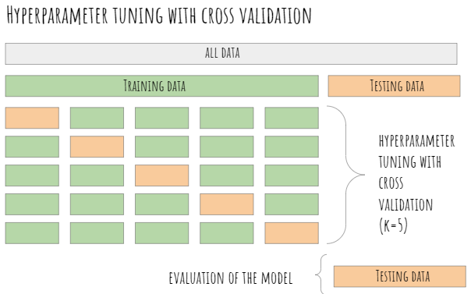
Hyperparameter tuning
We’ll split our data into a training set for learning the parameters of the model, and a testing set for evaluating its performance. The next step in the machine learning process is to perform hyperparameter tuning. The selection of hyperparameters consists of testing the performance of the model against different combinations of hyperparameters, selecting those that perform best according to a chosen metric and a validation method.
For hyperparameter tuning, we need to split our training data again into a set for training and a set for testing the hyperparameters (often called validation set). It is a very common practice to use k-fold cross-validation for hyperparameter tuning. The training set is divided again into k equal-sized samples, 1 sample is used for testing and the remaining k-1 samples are used for training the model, repeating the process k times. Then, the k evaluation metrics (in this case the accuracy) are averaged to produce a single estimator.
It is important to stress that the validation set is used for hyperparameter selection and not for evaluating the final performance of our model.

Slide 18
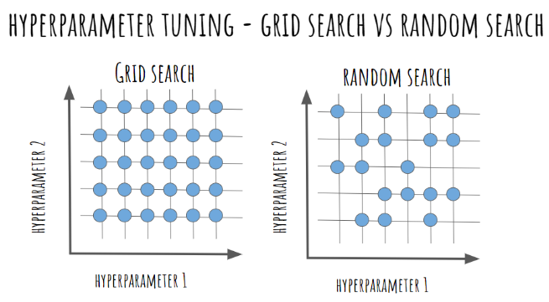
There are multiple techniques to find the best hyperparameters for a model. The most popular methods are (1) grid search, (2) random search, and (3) bayesian optimization. Grid search test all combinations of hyperparameters and select the best performing one. It is a really time-consuming method, particularly when the number of hyperparameters and values to try are really high.
In random search, we’ll specify a grid of hyperparameters, and random combinations are selected where each combination of hyperparameters has an equal chance of being sampled. We do not analyze all combinations of hyperparameters, but only random samples of those combinations. This approach is much more computationally efficient than trying all combinations; however, it also has some disadvantages. The main drawback of random search is that not all areas of the grid are evenly covered, especially when the number of combinations selected from the grid is low.

Slide 19
We can implement random search in Scikit-learn using the RandomSearchCV class from the sklearn.model_selection package.
First of all, we specify the grid of hyperparameter values using a dictionary (grid_parameters) where the keys represent the hyperparameters and the values are the set of options we want to evaluate. Then, we define the RandomizedSearchCV object for trying different random combinations from this grid. The number of hyperparameter combinations that are sampled is defined in the n_iter parameter. Naturally, increasing n_iter will lead in most cases to more accurate results, since more combinations are sampled; however, on many occasions, the improvement in performance won’t be significant.
After fitting the grid object, we can obtain the best hyperparameters using best_params_attribute. As you can above, the best hyperparameters are: {‘n_estimators’: 90, ‘min_samples_split’: 3, ‘max_features’: ‘log2’, ‘max_depth’: 3}.

Slide 20
Performance of the model
The last step of the machine learning process is to check the performance of the model (best hyperparameters ) by using the confusion matrix and some evaluation metrics.
The confusion matrix, also known as the error matrix, is used to evaluate the performance of a machine learning model by examining the number of observations that are correctly and incorrectly classified. Each column of the matrix contains the predicted classes while each row represents the actual classes or vice versa. In a perfect classification, the confusion matrix will be all zeros except for the diagonal. All the elements out of the main diagonal represent misclassifications. It is important to bear in mind that the confusion matrix allows us to observe patterns of misclassification (which classes and to which extend they were incorrectly classified).

Slide 21
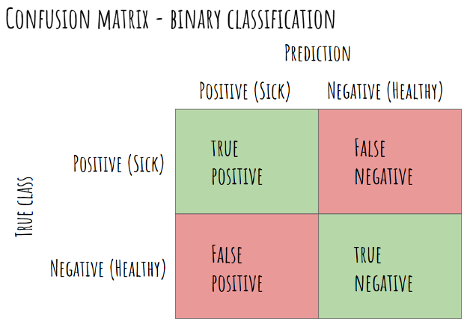
In binary classification problems, the confusion matrix is a 2-by-2 matrix composed of 4 elements:
TP (True Positive): number of patients with spine problems that are correctly classified as sick.
TN (True Negative): number of patients without pathologies who are correctly classified as healthy.
FP (False Positive): number of healthy patients that are wrongly classified as sick.
FN (False Negative): number of patients with spine diseases that are misclassified as healthy.

Slide 22
Now that the model is trained, it is time to evaluate its performance using the testing set. First, we use the previous model (gradient boosting classifier with best hyperparameters) to predict the class labels of the testing data (with the predict method). Then, we construct the confusion matrix using the confusion_matrix function from the sklearn.metrics package to check which observations were properly classified. The output is a NumPy array where the rows represent the true values and the columns the predicted classes.

Slide 23




Evaluation metrics
Evaluating the quality of the model is a fundamental part of the machine learning process. The most used performance evaluation metrics are calculated based on the elements of the confusion matrix.
Accuracy: It represents the proportion of predictions that were correctly classified. Accuracy is the most commonly used evaluation metric; however, it is important to bear in mind that accuracy can be misleading when working with imbalanced datasets.
Sensitivity: It represents the proportion of positive samples (diseased patients) that are identified as such.
Specificity: It represents the proportion of negative samples (healthy patients) that are identified as such.
Precision: It represents the proportion of positive predictions that are actually correct.

Slide 24
We can calculate the evaluation metrics manually using the numbers of the confusion matrix. Alternatively, Scikit-learn has already implemented the function classification_report that provides a summary of the key evaluation metrics. The classification report contains the precision, sensitivity, f1-score, and support (number of samples) achieved for each class.

Slide 25
Drawing conclusions — Summary
we have walked through a complete end-to-end machine learning project using the Telcommunication customer Churn dataset. We started by cleaning the data and analyzing it with visualization. Then, to be able to build a machine learning model, we transformed the categorical data into numeric variables (feature engineering). After transforming the data, we tried 6 different machine learning algorithms using default parameters. Finally, we tuned the hyperparameters of the Gradient Boosting Classifier (best performance model) for model optimization, obtaining an accuracy of nearly 80% (close to 6% higher than the baseline).
It is important to stress that the exact steps of a machine learning task vary by project. Although in the article we followed a linear process, machine learning projects tend to be iterative rather than linear processes, where previous steps are often revisited as we learn more about the problem we try to solve.

Slide 26
Thank You

